Slide 1


Intro to agent-based modelling for social scientists
Dr. J. Kasmire
Research Fellow at Cathie Marsh Institute and UK Data Service
Copyright © 2021 UK Data Service. Created by CSS Training Team, UK Data Service.

Slide 2
Interaction in this workshop
Zoom chat -> technical questions for facilitator
Zoom Q&A -> content questions for the host, upvote questions of others
Mentimeter -> anonymous on screen votes/short answer/etc. at clear key moments
Go to menti.com, enter 8 digit code at the top of the screen

Slide 3
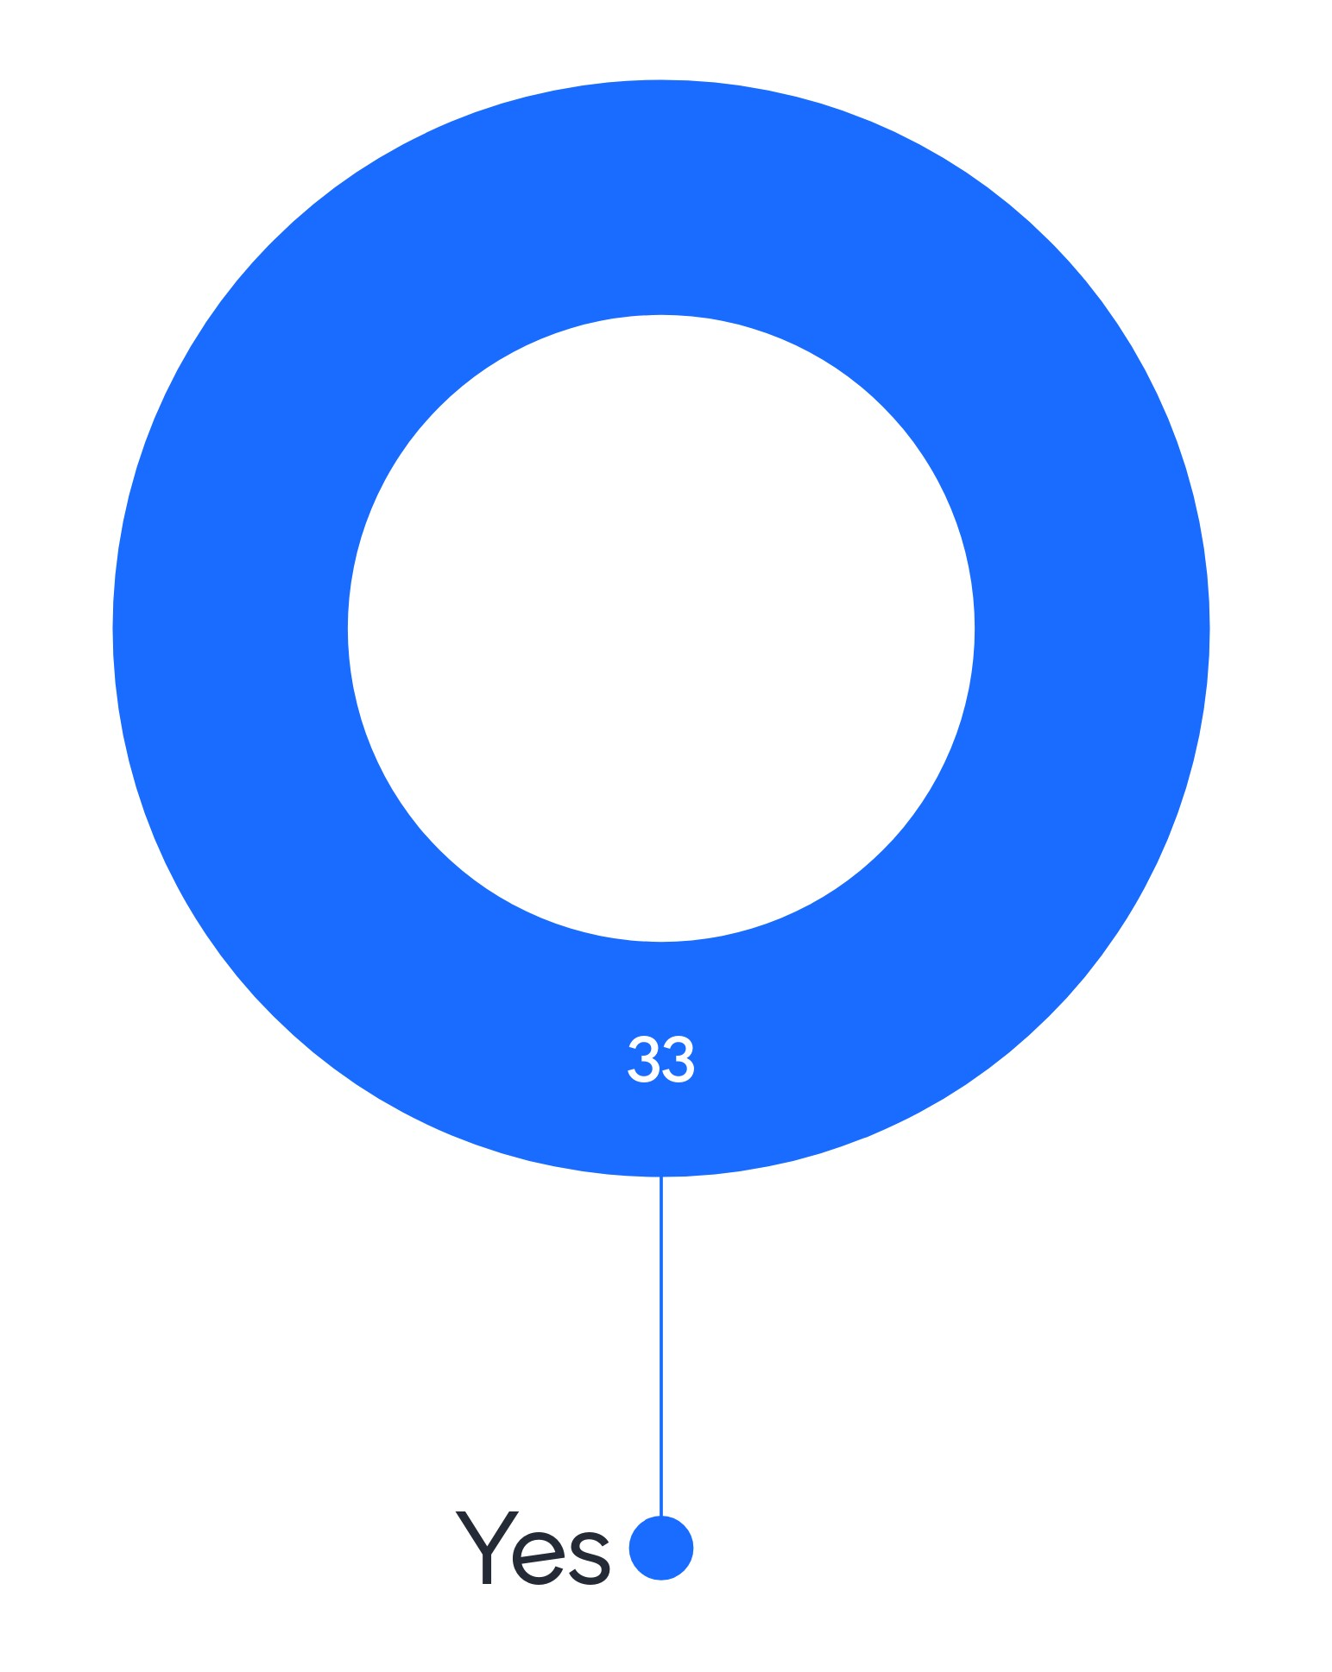
Can you hear us?

Slide 4
Troubleshooting audio problems
Check your speaker/headset is plugged in / volume is on.
Click on audio to change to listening via phone
We are recording this webinar and will post it on YouTube
(https://www.youtube.com/user/UKDATASERVICE)

Slide 5
You might be interested in other UKDS events
ABM workshop on using real-world data - Feb 2
ABM workshop on running experiments - Feb 16
ABM guest researcher seminar - Mar 9
CSS Drop-ins – Every 2nd Tuesday of month at 13:00
https://ukdataservice.ac.uk/news-and-events/events.aspx
https://www.ukdataservice.ac.uk/news-and-events/events/past-events.aspx

Slide 6
Table of contents
Top-down vs. Bottom-up
Agents and agent-based models
Simple example
Complex example
What to do with the output
Pros and cons of ABM, platforms/ languages, resources, etc.
Q&A

Slide 7
A problem ‘is’ top-down if:
Within a system that is ‘whole’, ‘well-understood’ and with central control or structure
The ‘cause’ can be isolated to constituent parts, defined interactions, or specific problem areas
It is well-suited to ‘classic scientific method’ which focusses on isolation, prediction, repetition, etc.

Slide 8

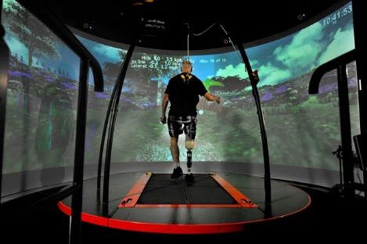

Top-down examples

Slide 9
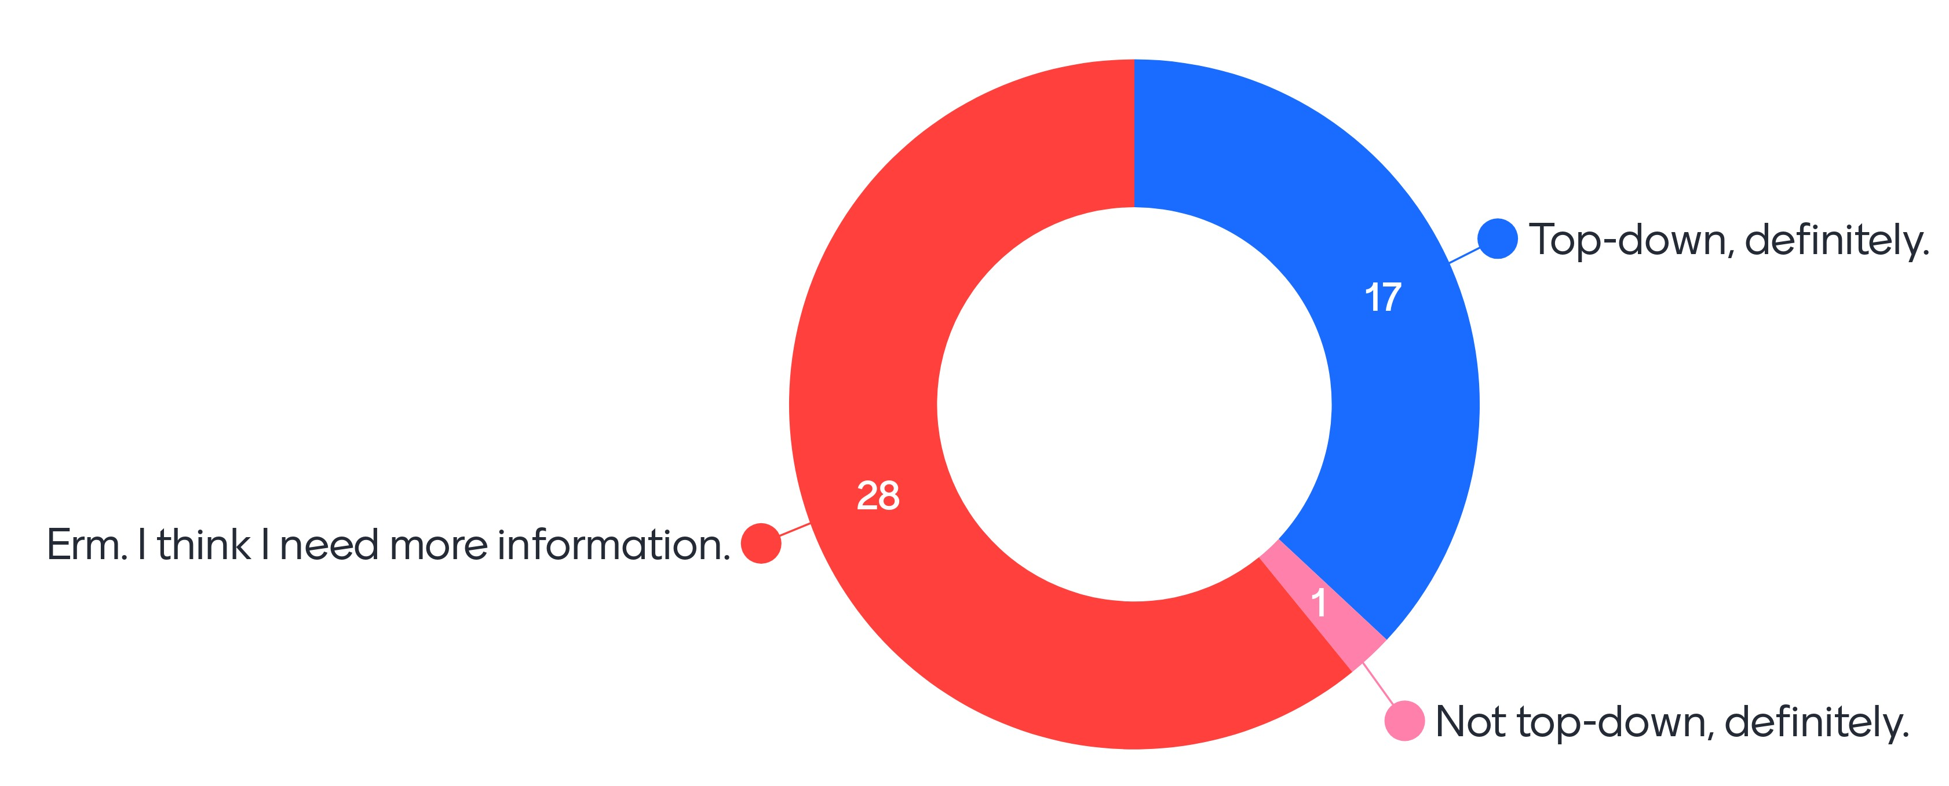
A school wants to know how many students it can accommodate. Is this a top-down problem?

Slide 10
A problem ‘is’ bottom-up if:
Within a poorly-understood, open system with vague parts/interactions and partial/decentralised control
Not reasonable to assume reducibility, linearity, time/context-independence, or closed/simplicity
Not easy to apply classic scientific method
Best understood by trying to recreate it

Slide 11
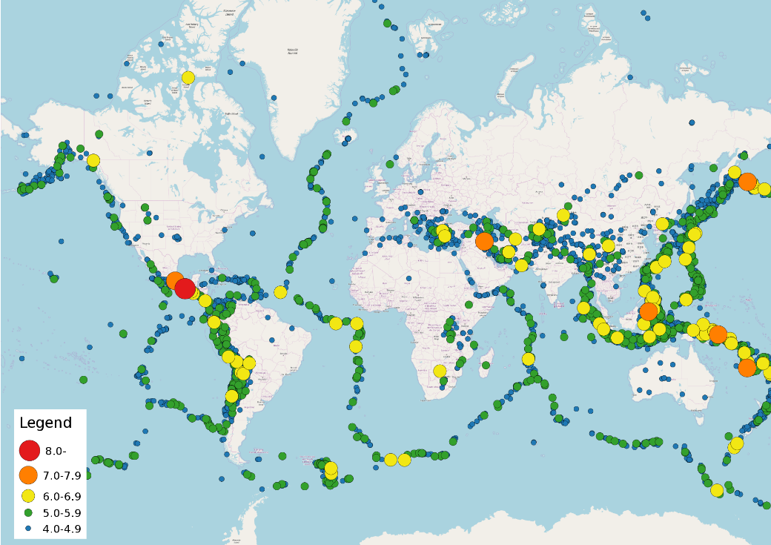
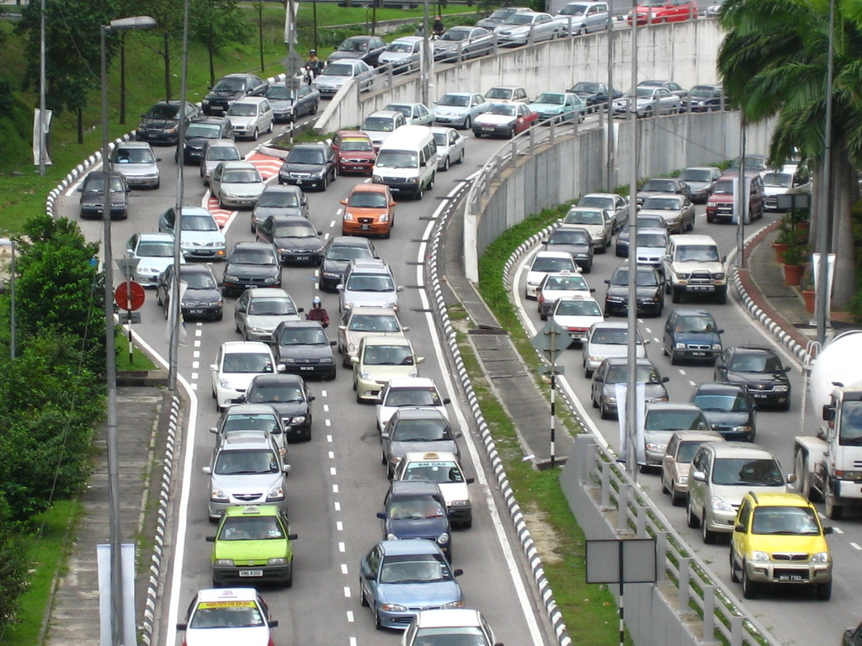

Bottom-up examples

Slide 12
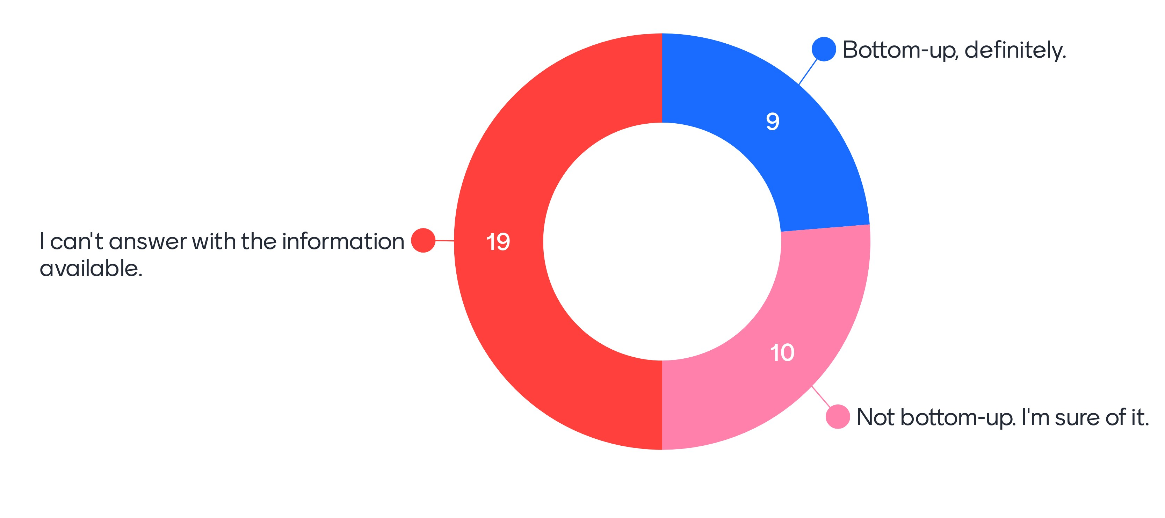
A school wants to know how to improve student attainment. Is this a bottom-up problem?

Slide 13

Agents – Artificial Intelligence
Artificial Intelligence
Learners and/or problem solvers
Autonomous
Individual

Slide 14
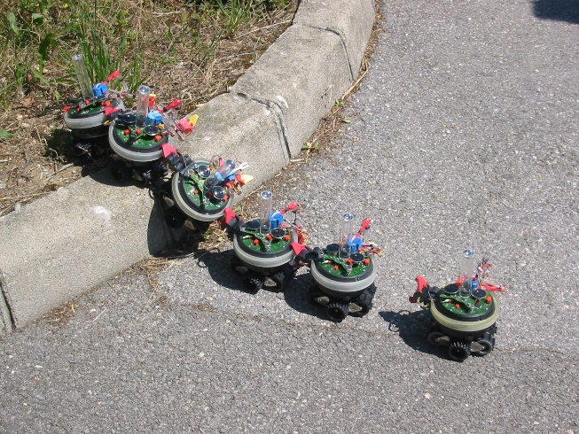
Agents – Multi-agent systems
Multi-agent systems
Distributed control
Specific problems

Slide 15
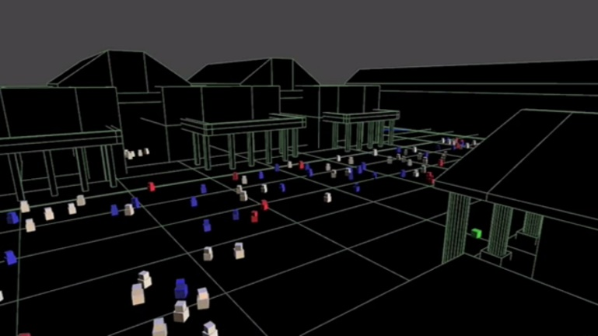
Agents – Three common views
Agent-based models
Multiple
Interacting
Rule-based

Slide 16
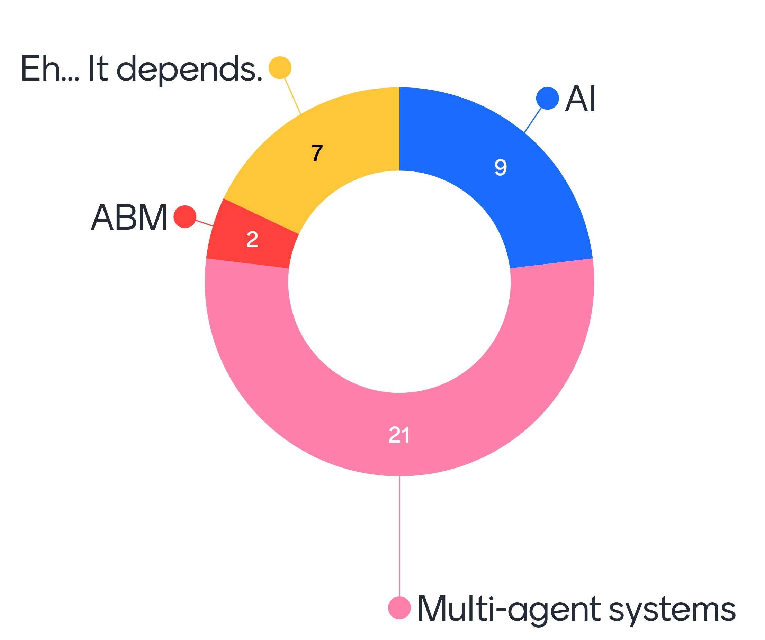
Are ‘smart’ traffic lights AI, multi-agent systems or ABM?

Slide 17
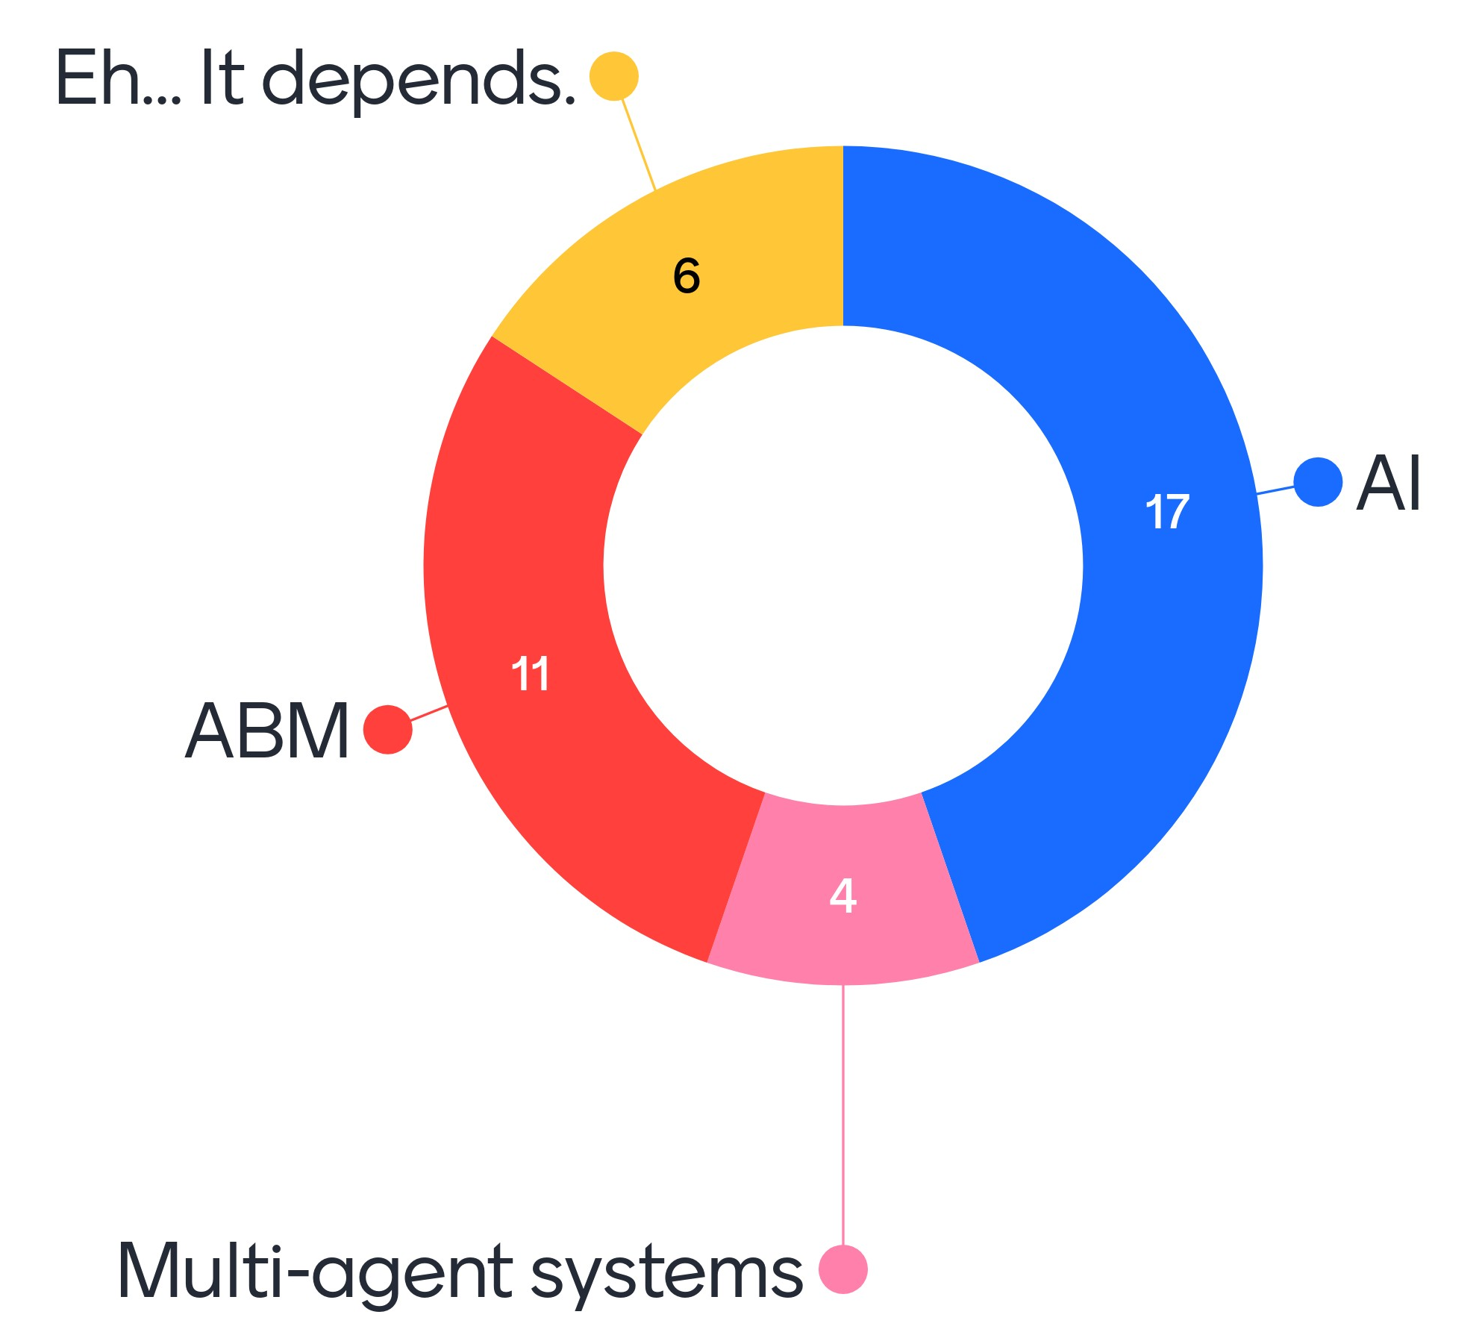
Are weather predictions AI, multi-agent systems or ABM?

Slide 18
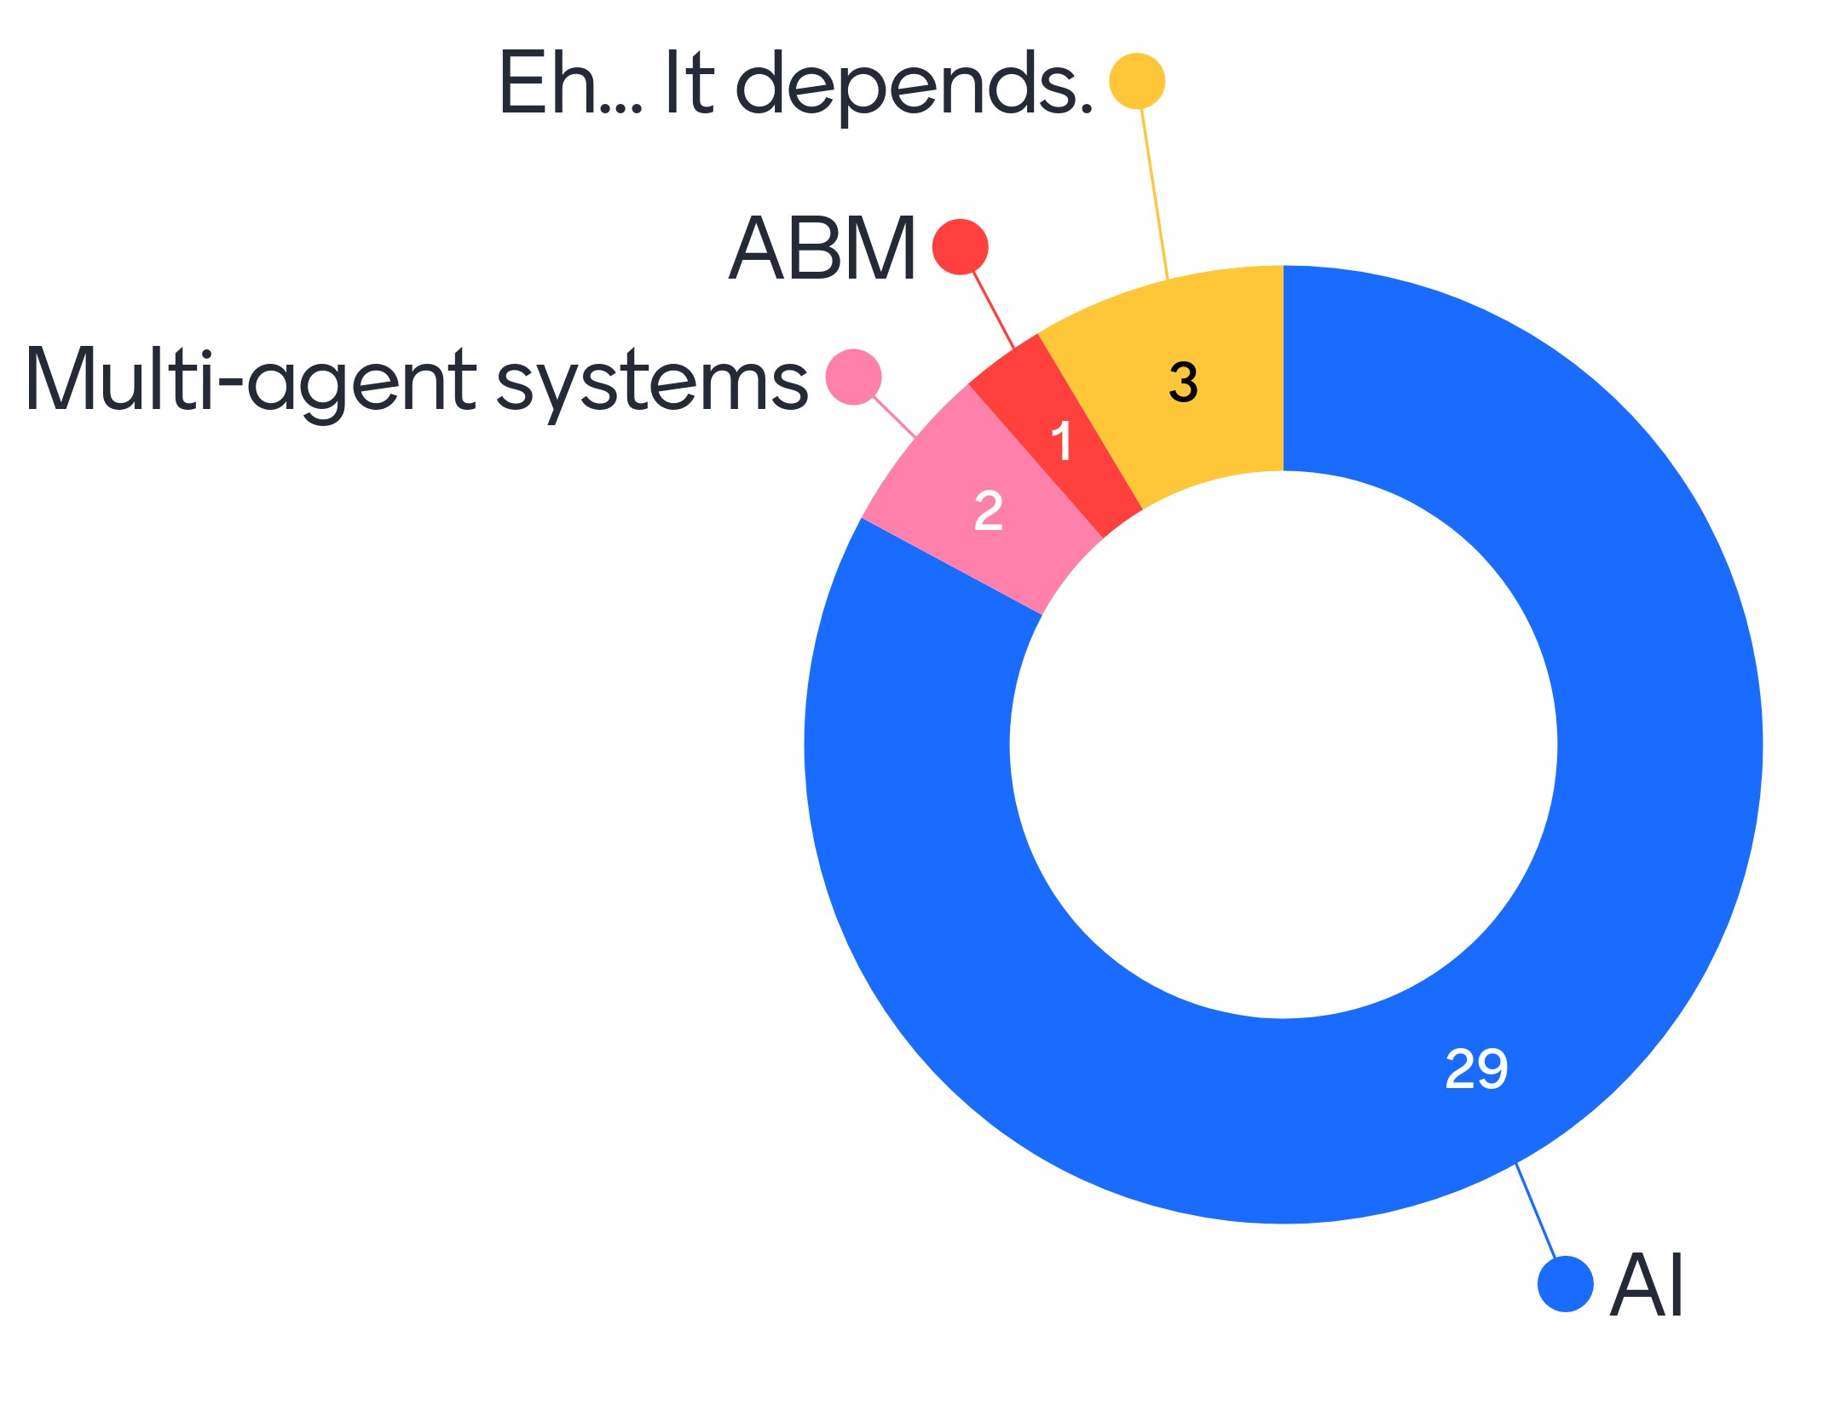
Are self-parking cars AI, multi-agent systems or ABM?

Slide 19
Agent-based models have:
A simulated world that has:
States
Rules
Objects and/or agents that have:
States
Rules

Slide 20

Agent-based models: The World can represent
Any scale (family, city, country, etc.)

Slide 21
Agent-based models: The World
Can represent any scale (family, city, country, etc.)
Proceeds through time in discrete ‘time steps’
Includes potentially relevant factors (population, weather, infrastructure, laws, etc.)
Is unique for each agent as it contains everything else (including other agents)
Has states and follows rules (more on this later)

Slide 22

Agent-based models: The Agents can represent
Most things (people, cars, unis, etc.)

Slide 23
Agent-based models: The Agents
Can represent most things (people, cars, unis, etc.)
Includes potentially relevant factors (bank balance, age, colour, speed, competitive ranking, etc.)
Are unique and behave uniquely
Have states and follow rules
Make decisions

Slide 24
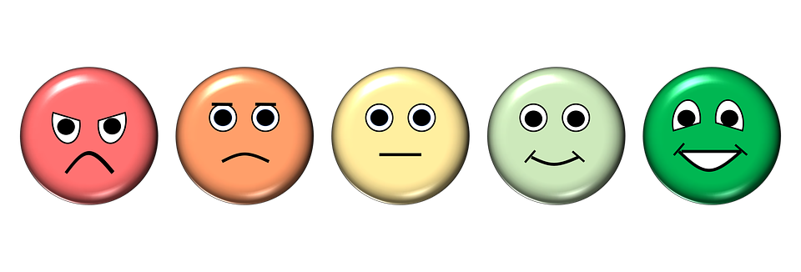
Agent-based models: States are
Sum of current features

Slide 25
Agent-based models: States
Sum of current features
Can be dynamic/static and can randomness
Current state can be influenced by previous state (of self or others) according to rules
Current state can influence future state (of self or others) according to rules

Slide 26

Agent-based models: Rules govern
How states change or decisions are made

Slide 27
Agent-based models: Rules
Govern how states change or decisions are made
Use model generated info (states), modeller choice, randomness
Can be simple or complex

Slide 28
Example rules:
If [weather = raining] and [temp = cold]
[travel by bus]
Else [travel by bike]
While [interest rates <= X]
[borrow and spend, do not save]
For each [school-age child in house]
[spend X money on school fees/uniform/etc.]

Slide 29
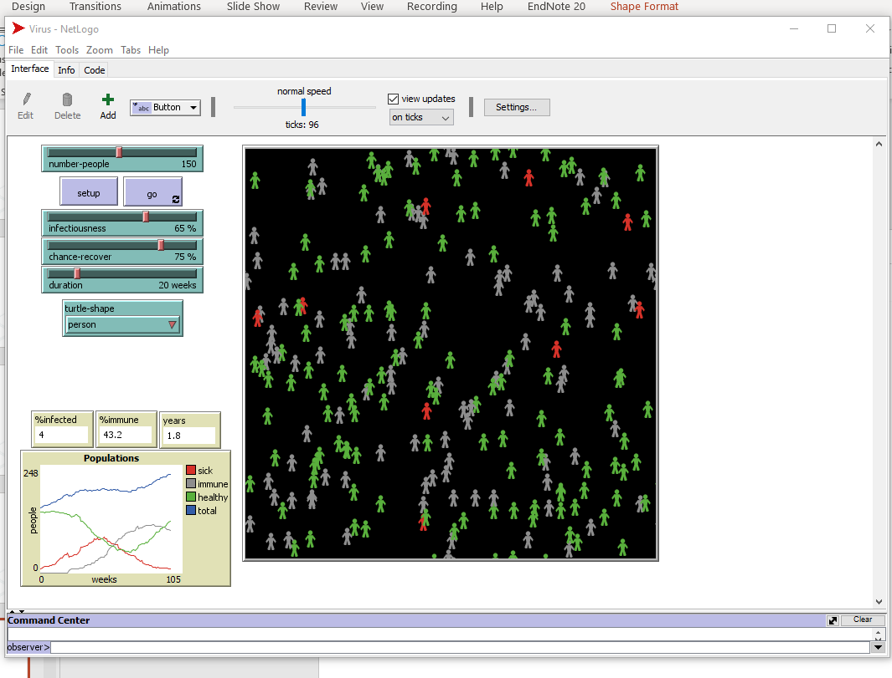
A simple example - Virus

Slide 30
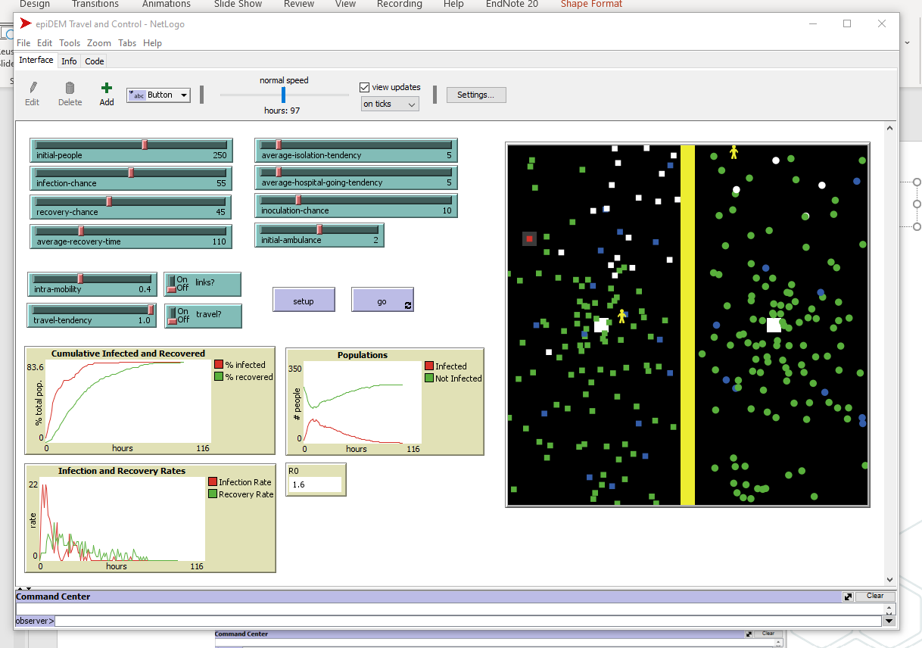
A complex example - Virus

Slide 31

OK… but why an ABM?
How things will interact is not intuitive.

Slide 32
Test your intuition.
Try to imagine what will happen in the complex virus model if we change:
Number of agents?
Infectiousness?
Change of recovery?
Average recovery time/duration?
Anything else not in simple model (e.g. likelihood of going to hospital, etc.)

Slide 33
What to do with the output?
Depends on the ABM, but common options include:
Parameter sweeps and/or interaction testing
Outcome probabilities
Emergent phenomenon identification
Export to other analysis method (e.g. social network analysis)

Slide 34
Pros of ABM
No need to rely on intuition for complex behaviours
Formalise mental models for inspection by others
Force abstract concepts into concrete represention
Relatively cheap/easy way to test the ‘untestable’
Potentially very fast
Can show range of possible futures
Can use real data, training data, random data, etc.
Can run multiple times (with or without changes)
Can be very intuitive

Slide 35
Cons of ABM
Mental models (and ABM based on them) can be tricky to reflect critically on
Concrete representations may not adequately capture abstract concepts
Speed lends itself to ‘prediction’
Possible futures are hard to turn into risk profiles
Can give false sense of security and truthiness
Computational methods may motivate distrust/unwarranted trust
Easy to misunderstand

Slide 36
Platforms, languages, etc.
Free, open-source, relatively small download size, tutorials and info available on web
Mason – focus on easy to learn, not most well recognised
Repast – more powerful, steeper learning curve
NetLogo – built in visualisation, not most powerful
EMLab-Agentspring – modular, not most well recognised
Object-oriented software (e.g. Python) – extremely powerful, not targeted, hard to learn/find answers

Slide 37
Resources for learning more
https://en.wikipedia.org/wiki/Comparison_of_agent-based_modeling_software
https://en.wikipedia.org/wiki/Agent-based_model
https://www.comses.net/
https://ccl.northwestern.edu/netlogo/docs/dictionary.html
https://ccl.northwestern.edu/netlogo/docs/tutorial1.html

Slide 38
Summary
Top-down: reducible, isolatable, straightforward
Bottom-up: non-intuitive large-scale effect of many small acts
Agents: heterogeneous actors that observe, decide, act
ABM: bottom-up simulation with easy testing
Pros: can be inspected, cheap, easy, fast, can do ‘impossible’ experiments
Cons: simplify complex concepts, misused for prediction, misunderstood

Slide 39
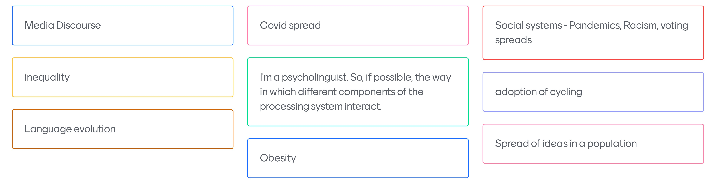
What would you use ABM to explore? 1

Slide 40
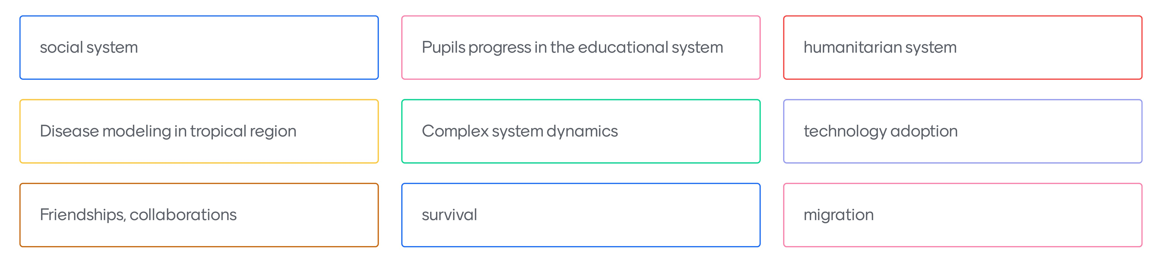
What would you use ABM to explore? 2

Slide 41
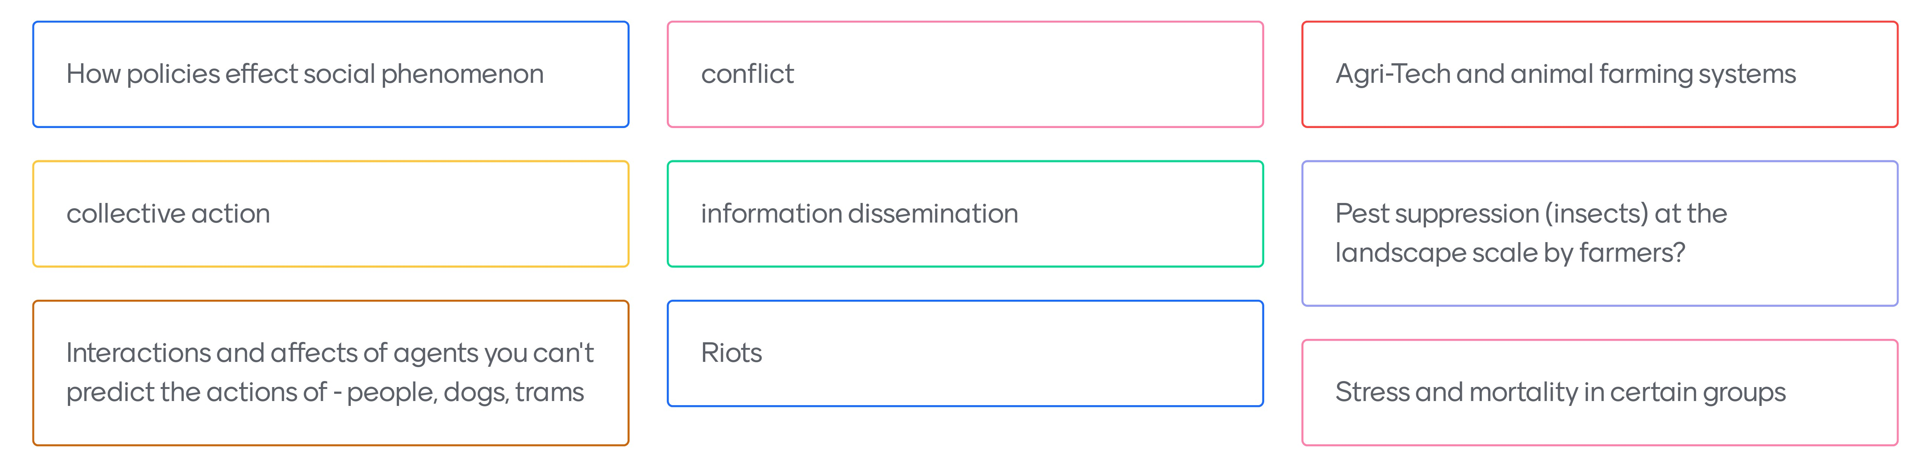
What would you use ABM to explore? 3

Slide 42
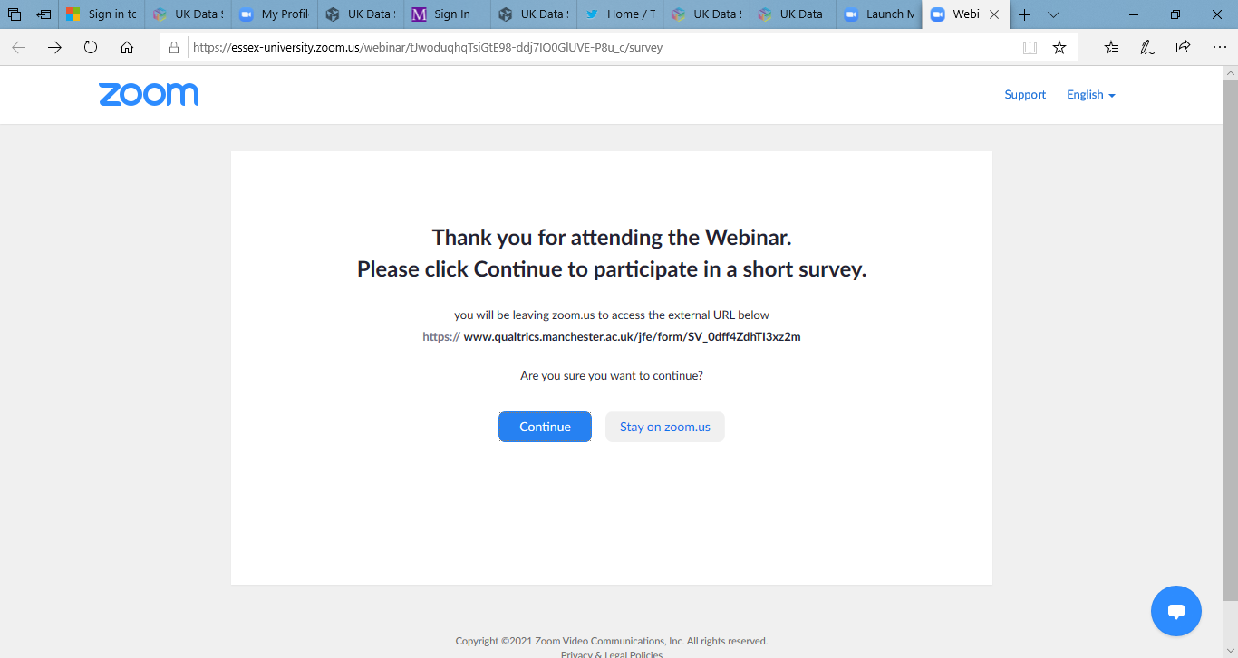
Evaluation
When you leave the webinar, please complete our short survey.
Just click on ‘continue’ to access the survey.

Slide 43

Thank you.
Dr. J. Kasmire
Email to j.kasmire@manchester.ac.uk
@JKasmireComplex on Twitter
@UKDataService on Twitter

